Slide 1
Analysis Of COVID-19 Data
Manish Hemnani
Piyush Prakash
Avinash Kumar

Slide 2
Content
Introduction
Primary goals
Challenges
Dashboard Description
Outcomes

Slide 3
INTRODUCTION
Covid-19 has major impact on India, with most of the population ​affected by it. And this project was done to extract the Gist of the data provided by the Government of India, and draw Insight based on different parameter present in it.

Slide 4
PRIMARY GOALS
Understand the data.
Convert Data in a Usable Format (using Python)
Design Dataset which can give useful insight (Using SQL)
Visualize data to see different trends (Using Excel)

Slide 5
Challenges Faced
Due to huge amount of data, It was difficult to segregate the data into usable format
Error Handling
Database Creation, and figuring out which table to use to draw insight
Selection of type of Graph, which can display the data in most accurate way possible.

Slide 6
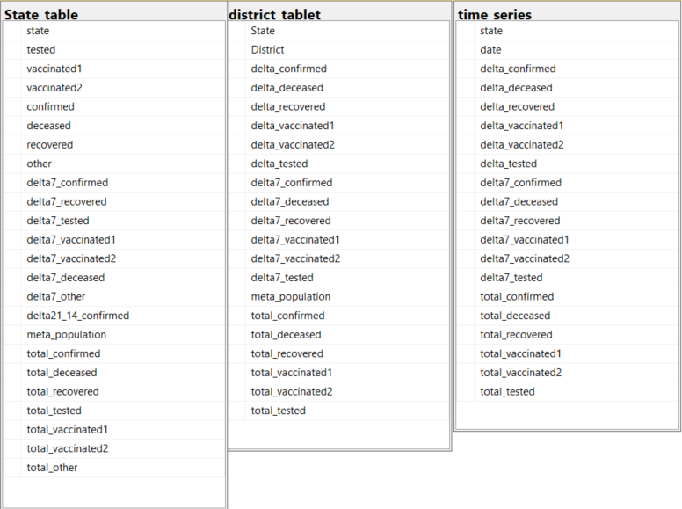
Table Attributes

Slide 7
Results
Weekly Evolution
With the help of time series data, An evolution of Covid-19 cases was plotted, which includes data related to (Confirmed, recovered, deceased, vaccinated)
Categorization
In this every state is categorized in 5 different category, based on testing ratio.
Formula (testing ratio(tr) = (number of tests done) / (population))
Delta 7 Comparison
This was done to get an insight of ‘No of Confirmed Cases’ with respect to ‘No of vaccinated population’ on a weekly based data.
Monthly categorization
This was done in accordance to get the monthly data of total number of Covid19 cases, and to find out which month was most devasting for India.
Spoilers :- It was December of 2020

Slide 8
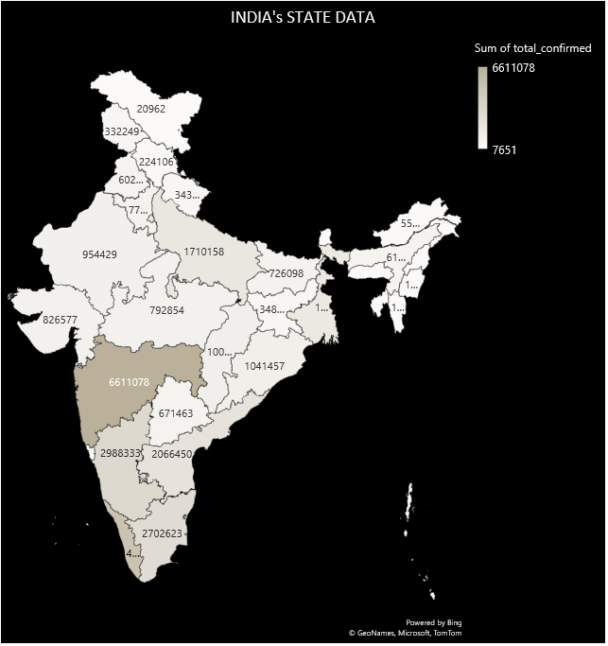
Map shows the distribution of confirmed cases in every state of India throughout the Covid19 Period.
Maharashtra was the State which was most impacted with
Covid19.

Slide 10
Graph for Karnataka, shows that the testing Count was the higher in Bengaluru Urban.
Similarly, for each state district wise data has been plotted which can be referenced with the
Help of dashboard Created.

Slide 12
No of cases For each month of 2020

Slide 13
Insight on Total Number of Confirmed and Deceased Cases

Slide 14
INSIGHT ON TOTAL NUMBER OF TESTED AND VACCINATED CASES

Slide 15
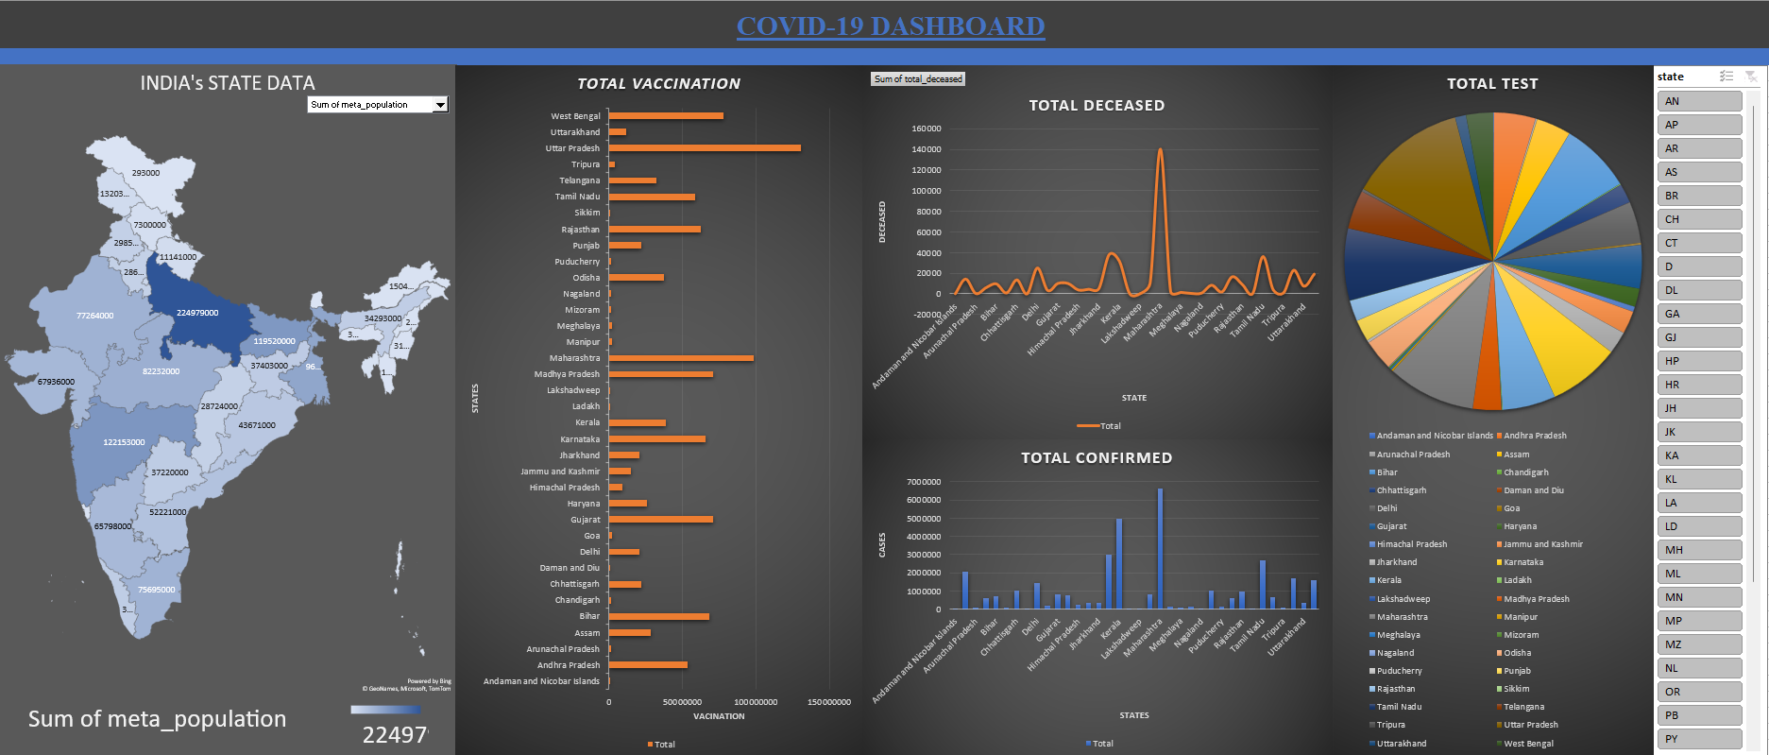
Excel dashboard

Slide 16
HOW WE GET HERE
Data Extraction and Sanitization
Data Manipulation
Data Visualization
With the help of one of the most powerful tool, named python
We extracted the data from the source file and the same tool helped us achieve our dataset in usable format.
Data was Manipulated with help of SQL, which not only gave up power to select the required data, but it helped us in maintain a uniform Structure throughout the process.
With the help of Microsoft Excel, we were able to achieve insights and visualize them in Real time with different changing Parameters.

Slide 17
THANK YOU

